Slide 1



School of Computing and Information Technology, Eastern International University (EIU) - Vietnam

Slide 2
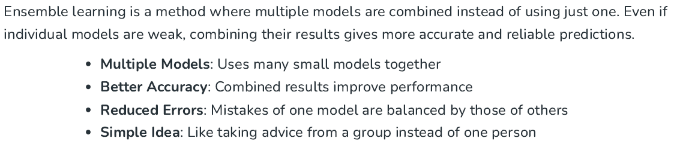
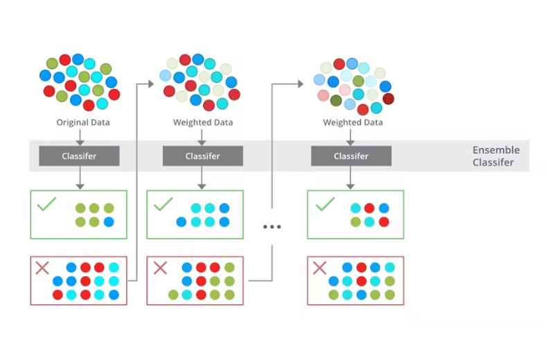
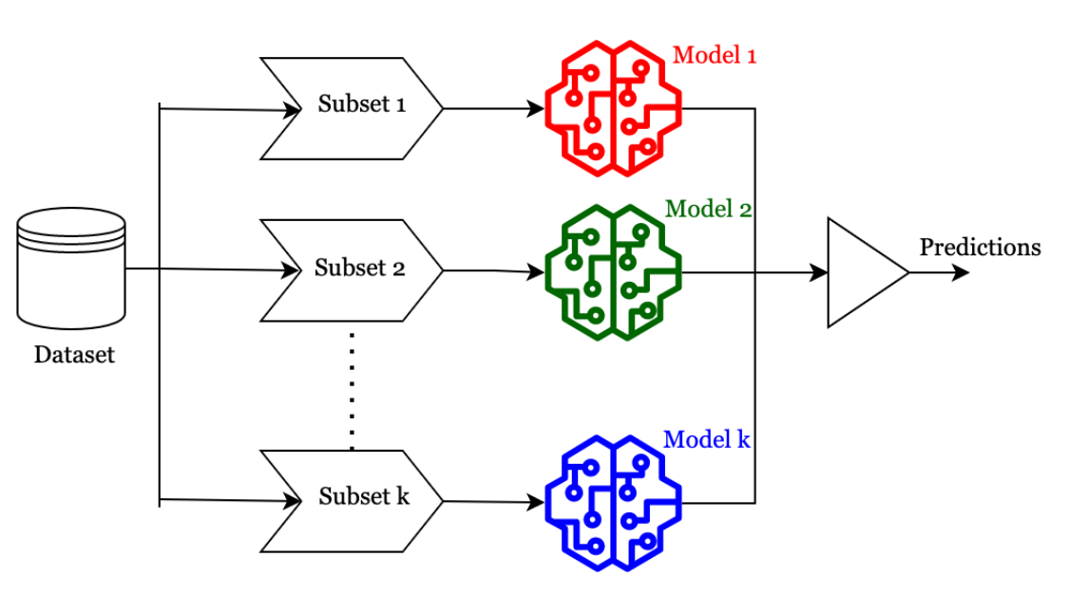
School of Computing and Information Technology, Eastern International University (EIU) - Vietnam

Slide 3
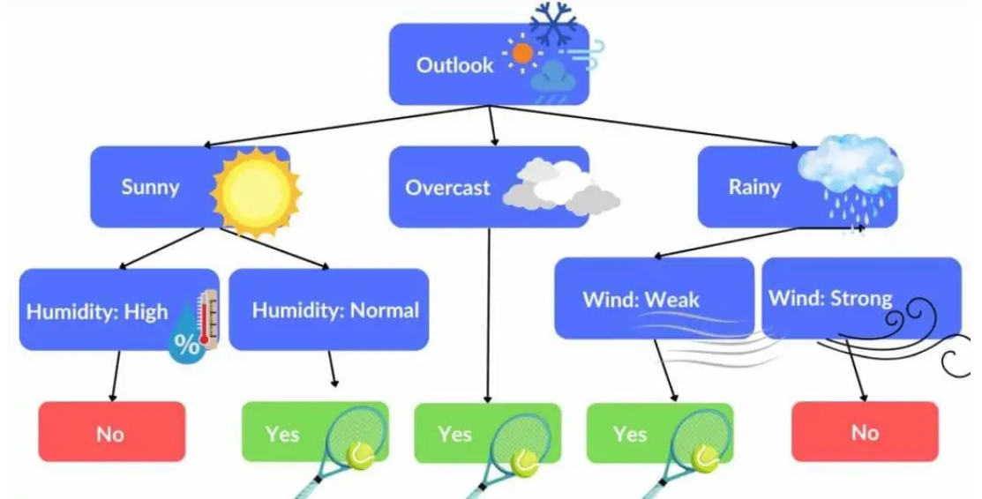


Slide 4

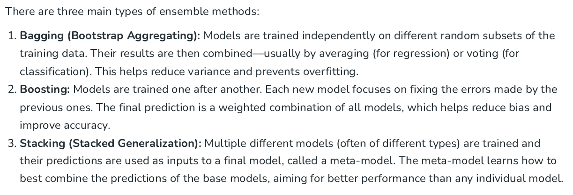
School of Computing and Information Technology, Eastern International University (EIU) - Vietnam

Slide 5
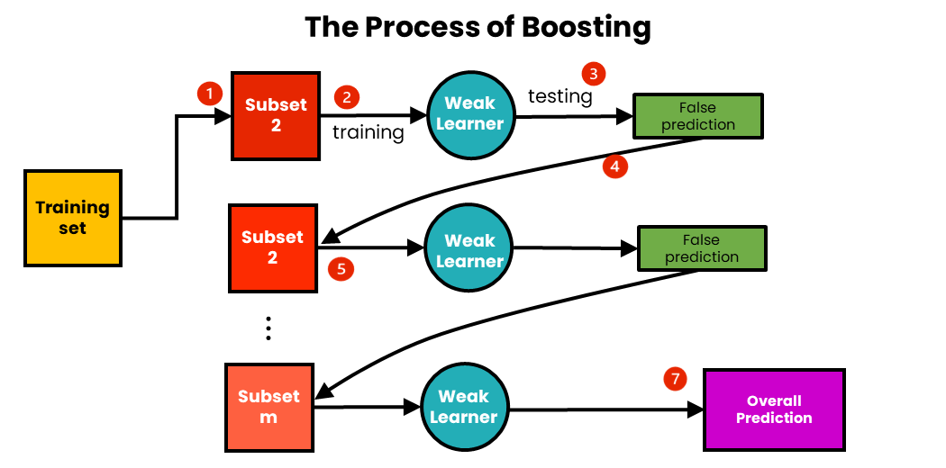
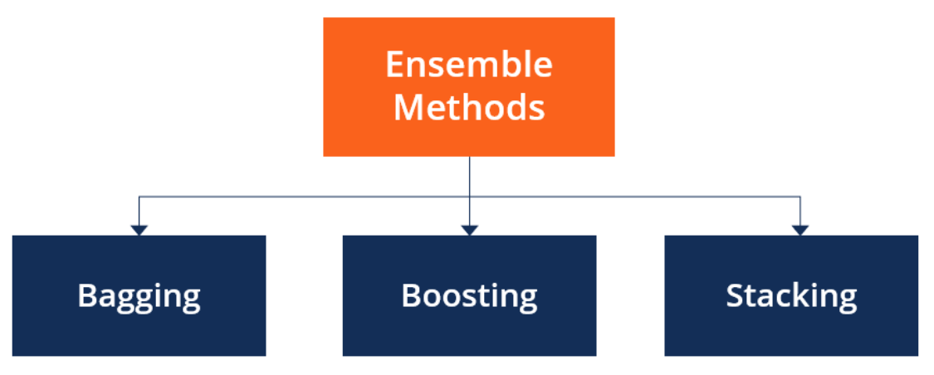
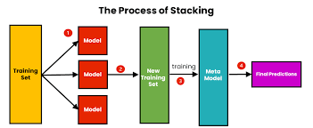
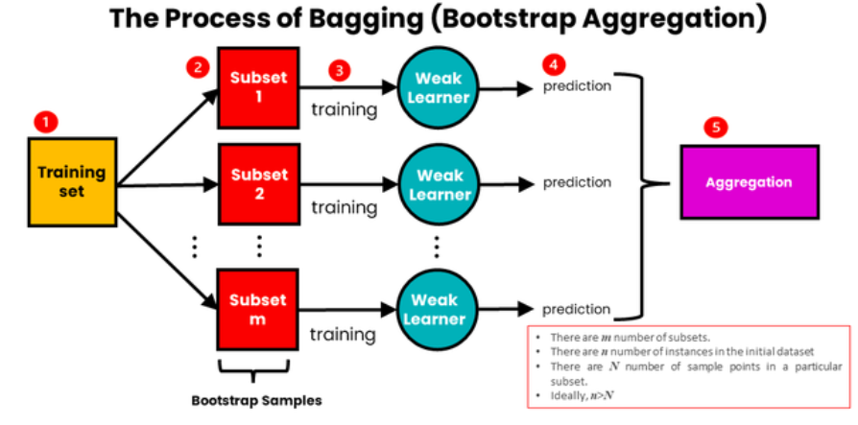

Slide 6

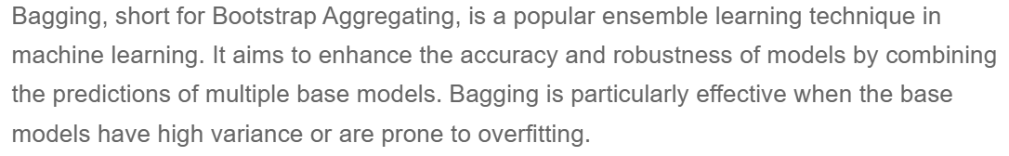
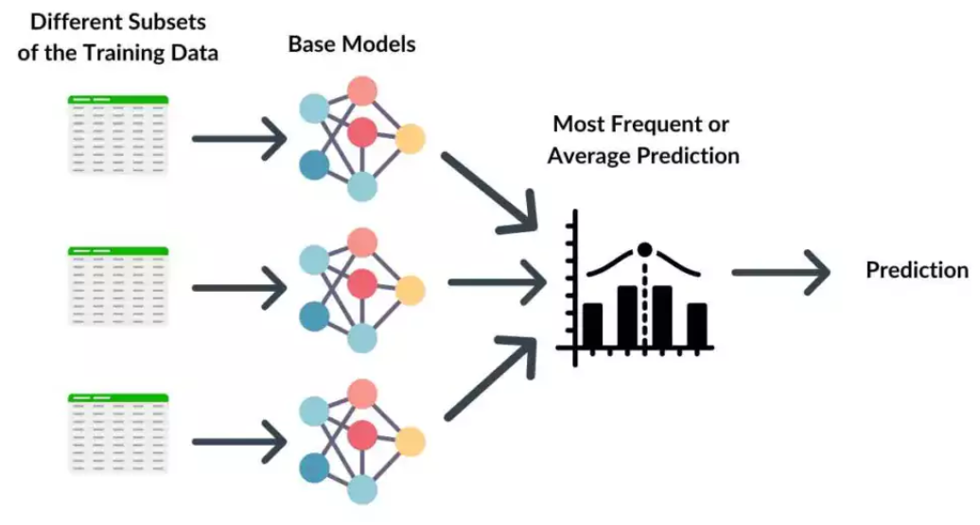

Slide 7
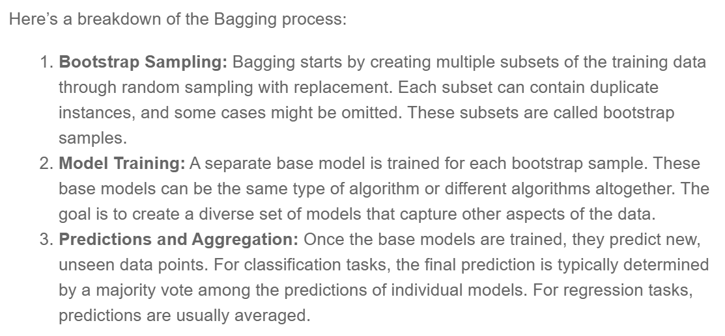
School of Computing and Information Technology, Eastern International University (EIU) - Vietnam

Slide 8
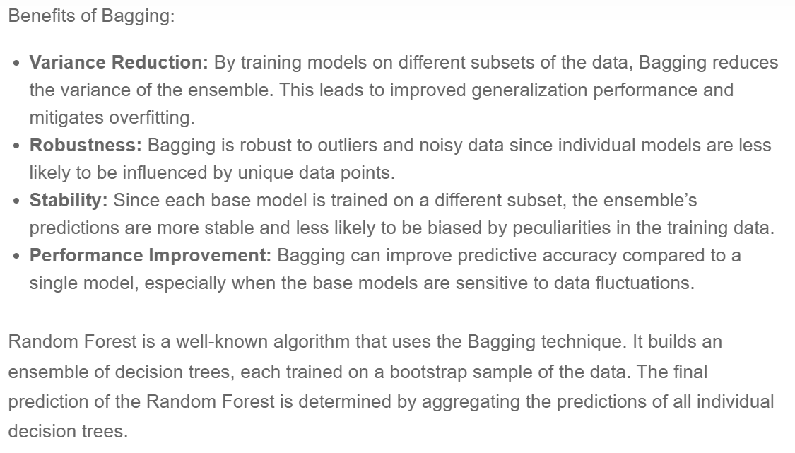
School of Computing and Information Technology, Eastern International University (EIU) - Vietnam

Slide 9

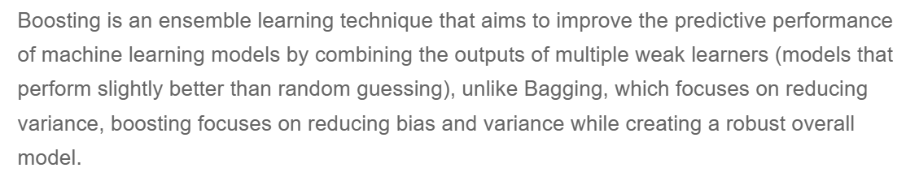
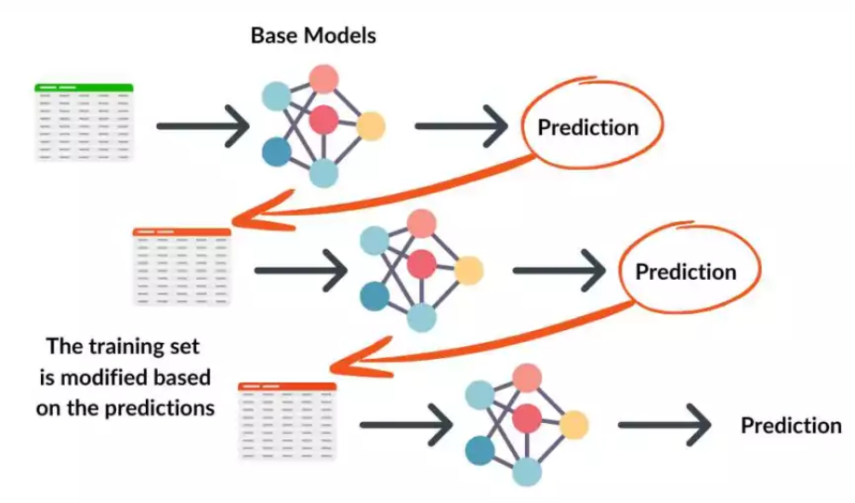

Slide 10
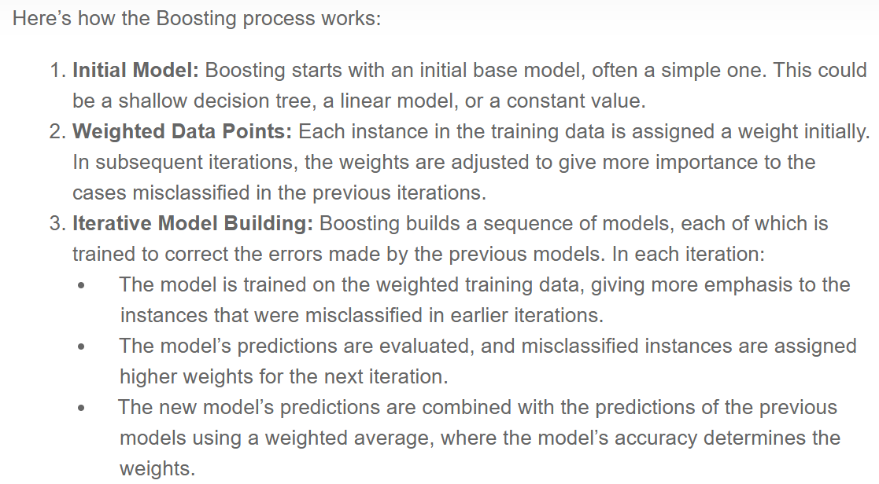
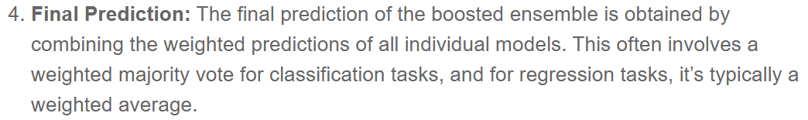

Slide 11
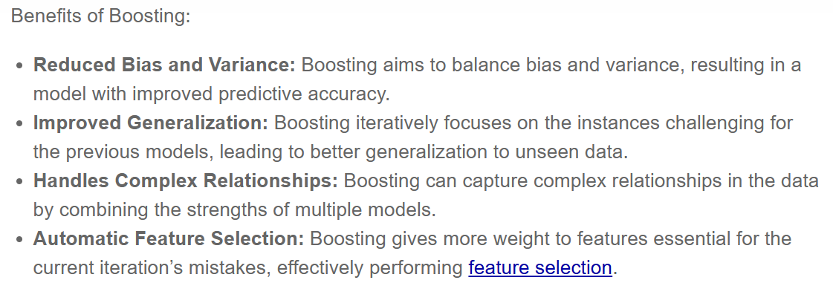
School of Computing and Information Technology, Eastern International University (EIU) - Vietnam

Slide 12
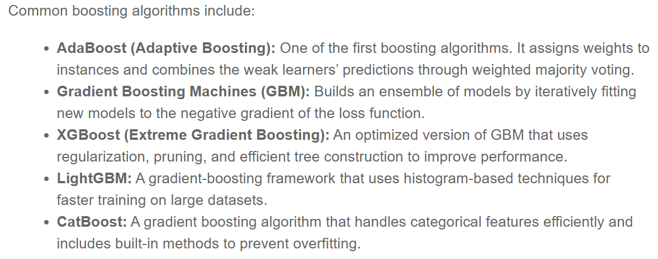
School of Computing and Information Technology, Eastern International University (EIU) - Vietnam

Slide 13

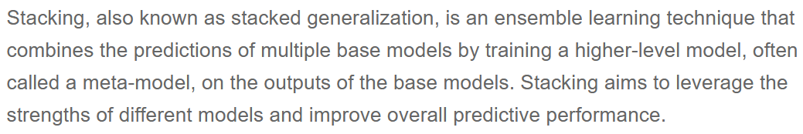
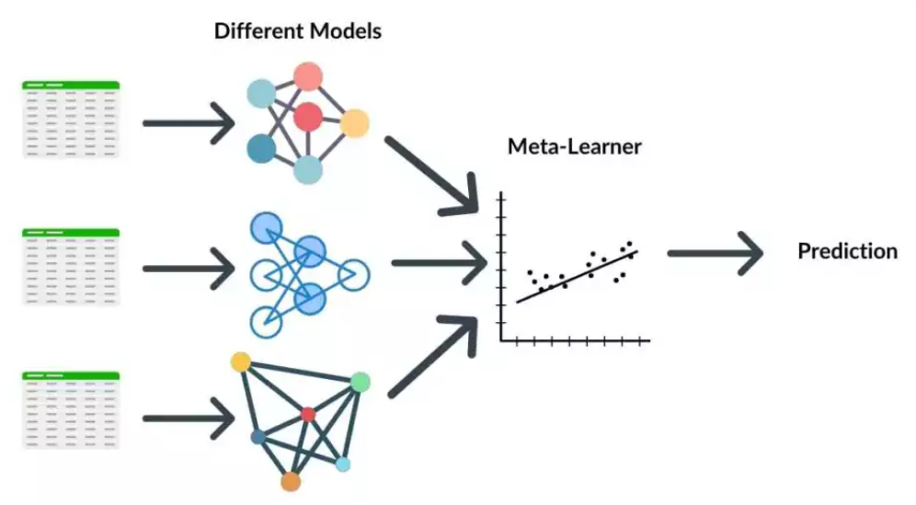
School of Computing and Information Technology, Eastern International University (EIU) - Vietnam

Slide 14
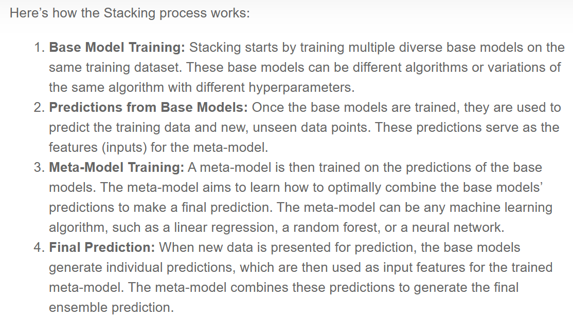
School of Computing and Information Technology, Eastern International University (EIU) - Vietnam

Slide 15
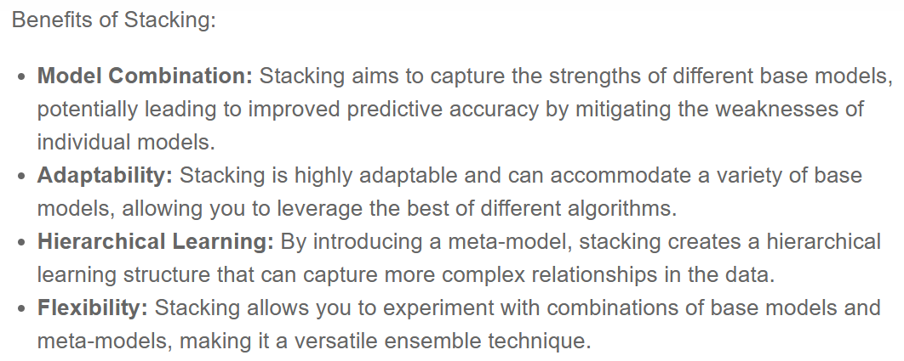
School of Computing and Information Technology, Eastern International University (EIU) - Vietnam

Slide 16
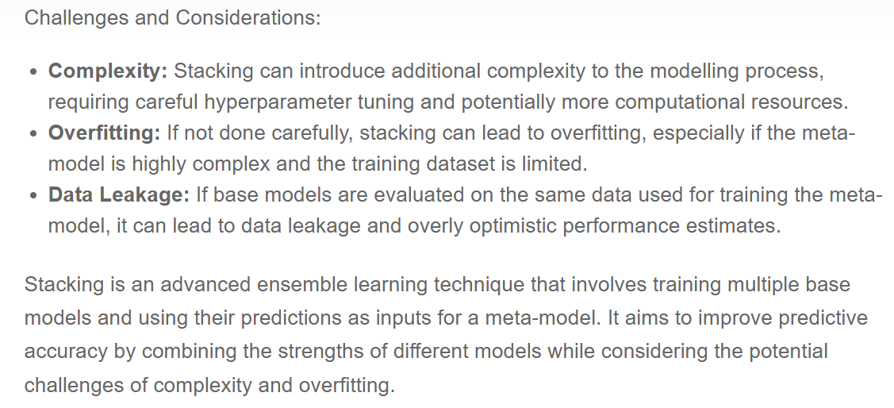
School of Computing and Information Technology, Eastern International University (EIU) - Vietnam

Slide 17
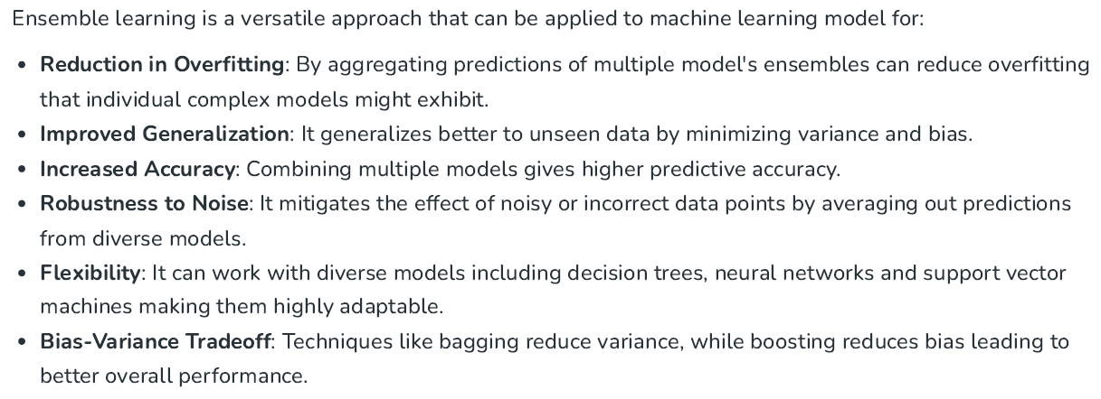
School of Computing and Information Technology, Eastern International University (EIU) - Vietnam

Slide 18
